Slide 1
Basics of information theory and information complexity
a tutorial
Mark Braverman
Princeton University
June 1, 2013

Slide 2
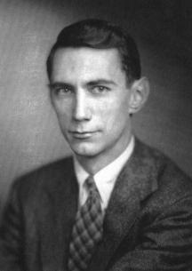




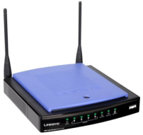
Part I: Information theory
Information theory, in its modern format was introduced in the 1940s to study the problem of transmitting data over physical channels.
communication channel
Alice
Bob

Slide 3
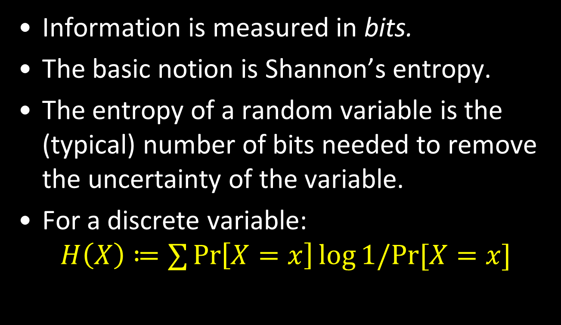
Quantifying “information”
Information is measured in bits.
The basic notion is Shannon’s entropy.
The entropy of a random variable is the (typical) number of bits needed to remove the uncertainty of the variable.
For a discrete variable:
$$H\left(X\right)≔∑\operatorname{Pr}\left[X=x\right]\log{1/Pr⁡[X=x]}$$

Slide 4
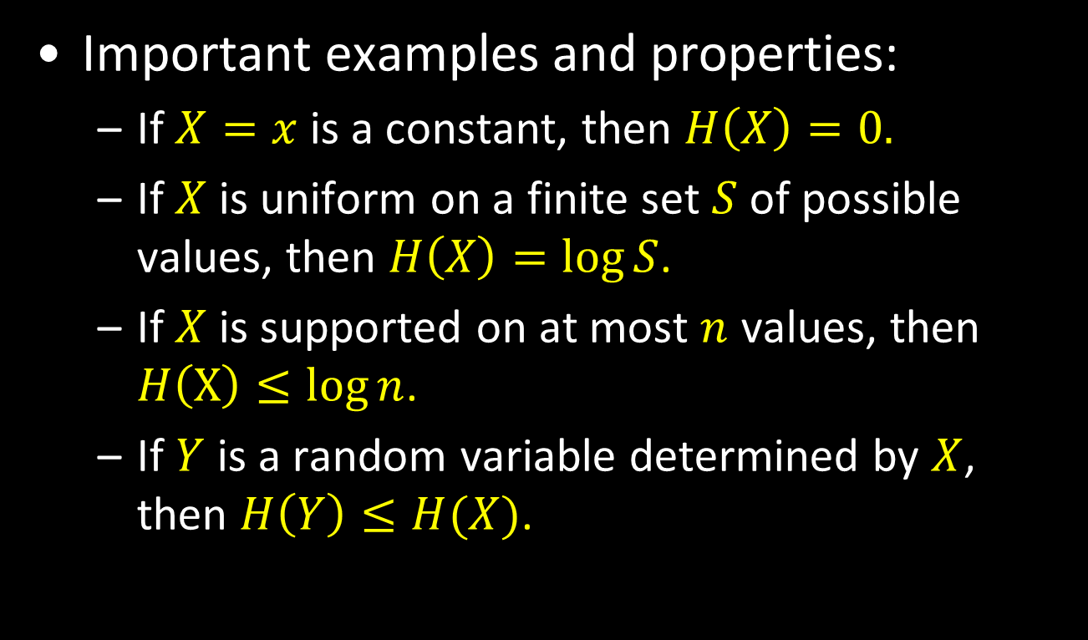
Shannon’s entropy
Important examples and properties:
If $X=x$ is a constant, then $H\left(X\right)=0.$
If $X$ is uniform on a finite set $S$ of possible values, then $H\left(X\right)=\log{S}$.
If $X$ is supported on at most $n$ values, then $H\left(X\right)≤\log{n}$.
If $Y$ is a random variable determined by $X$, then $H\left(Y\right)≤H(X)$.

Slide 5
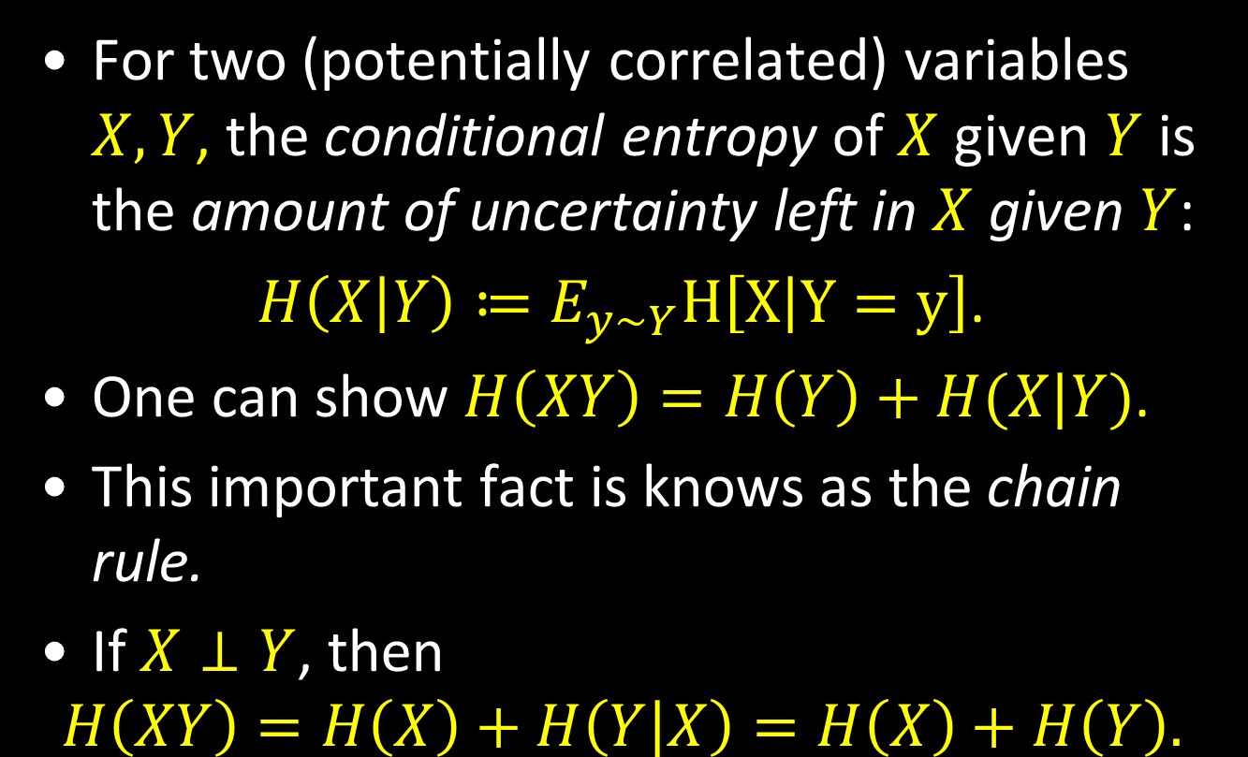
Conditional entropy
For two (potentially correlated) variables $X,Y$, the conditional entropy of $X$ given $Y$ is the amount of uncertainty left in $X$ given $Y$:
$H\left(X | Y\right)≔E_{y\sim Y}H\left[X | Y=y\right]$.
One can show $H\left(XY\right)=H\left(Y\right)+H(X|Y)$.
This important fact is knows as the chain rule.
If $X⊥Y$, then
$$H\left(XY\right)=H\left(X\right)+H\left(Y | X\right)=H\left(X\right)+H\left(Y\right).$$

Slide 6
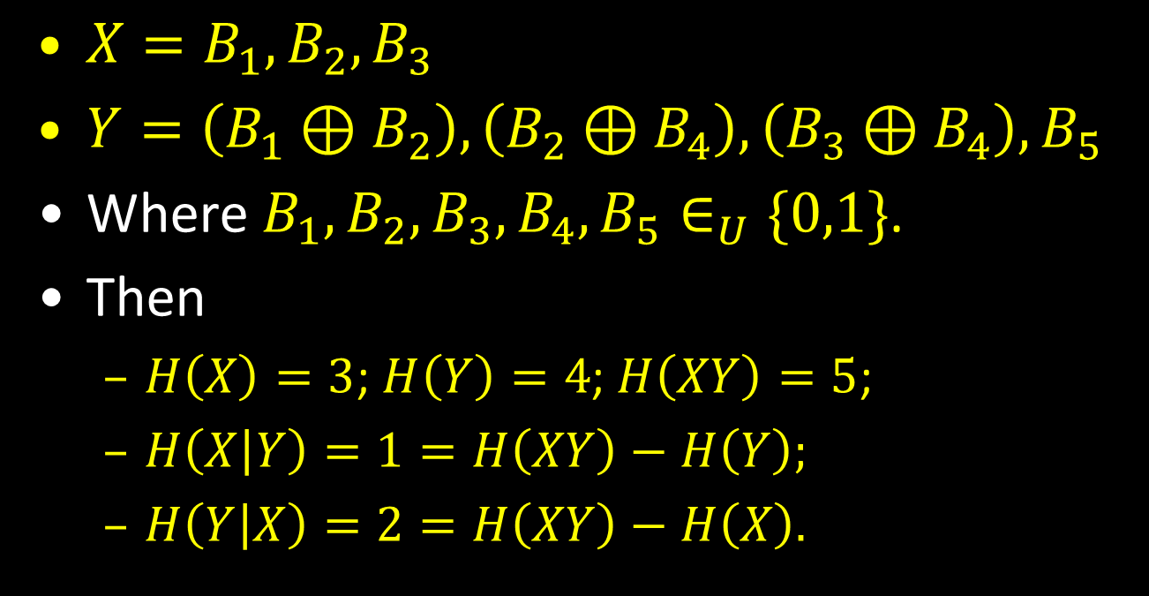
Example
$X=B_{1},B_{2},B_{3}$
$Y=\left(B_{1}⊕B_{2}\right),\left(B_{2}⊕B_{4}\right),\left(B_{3}⊕B_{4}\right),B_{5}$
Where $B_{1},B_{2},B_{3},B_{4},B_{5}∈_{U}\{0,1\}$.
Then
$H\left(X\right)=3$; $H\left(Y\right)=4$; $H\left(XY\right)=5$;
$H\left(X | Y\right)=1=H\left(XY\right)−H\left(Y\right);$
$H\left(Y | X\right)=2=H\left(XY\right)−H\left(X\right).$

Slide 7
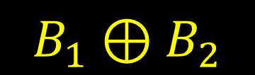

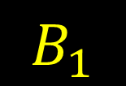
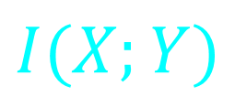
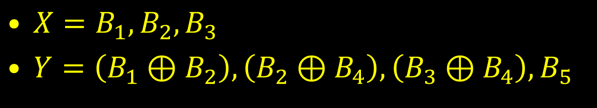



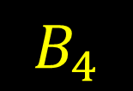

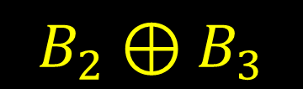
Mutual information
$X=B_{1},B_{2},B_{3}$
$Y=\left(B_{1}⊕B_{2}\right),\left(B_{2}⊕B_{4}\right),\left(B_{3}⊕B_{4}\right),B_{5}$
$$H(X)$$
$$H(Y)$$
$$H(Y|X)$$
$$H(X|Y)$$
$$I(X;Y)$$
$$B_{4}$$
$$B_{1}$$
$$B_{1}⊕B_{2}$$
$$B_{5}$$
$$B_{2}⊕B_{3}$$

Slide 8
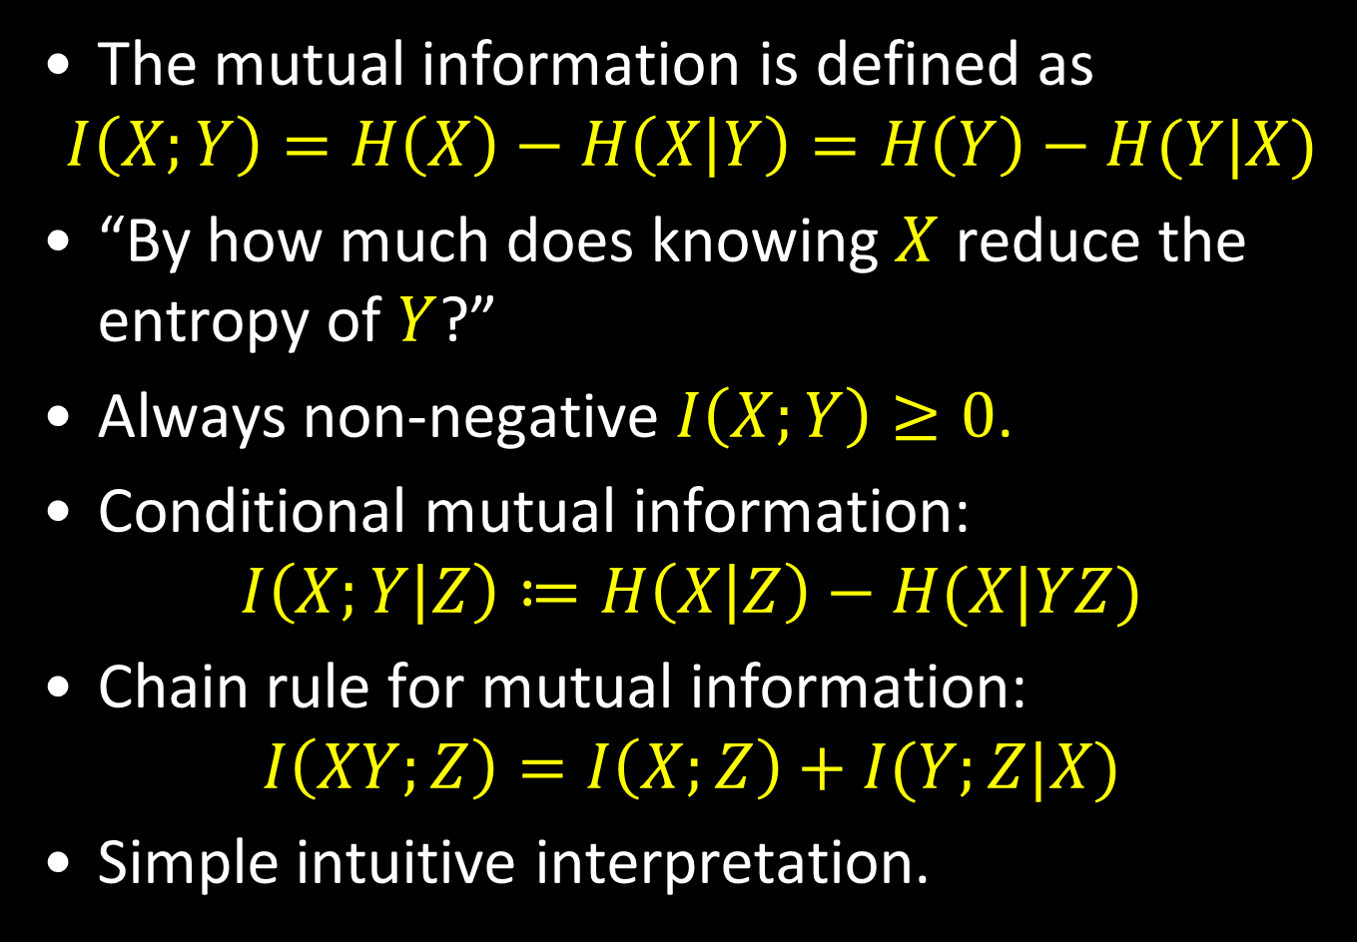
Mutual information
The mutual information is defined as
$$I\left(X;Y\right)=H\left(X\right)−H\left(X | Y\right)=H\left(Y\right)−H(Y|X)$$
“By how much does knowing $X$ reduce the entropy of $Y$?”
Always non-negative $I\left(X;Y\right)≥0$.
Conditional mutual information:
$$I\left(X;Y | Z\right)≔H\left(X | Z\right)−H(X|YZ)$$
Chain rule for mutual information:
$$I\left(XY;Z\right)=I\left(X;Z\right)+I(Y;Z|X)$$
Simple intuitive interpretation.

Slide 9
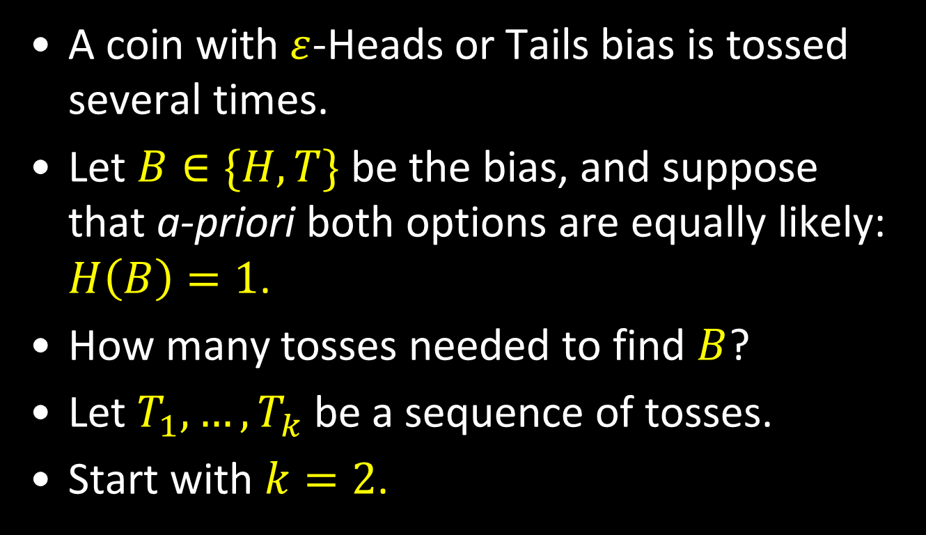
Example – a biased coin
A coin with $ε$-Heads or Tails bias is tossed several times.
Let $B∈\{H,T\}$ be the bias, and suppose that a-priori both options are equally likely: $H\left(B\right)=1$.
How many tosses needed to find $B$?
Let $T_{1},…,T_{k}$ be a sequence of tosses.
Start with $k=2$.

Slide 10
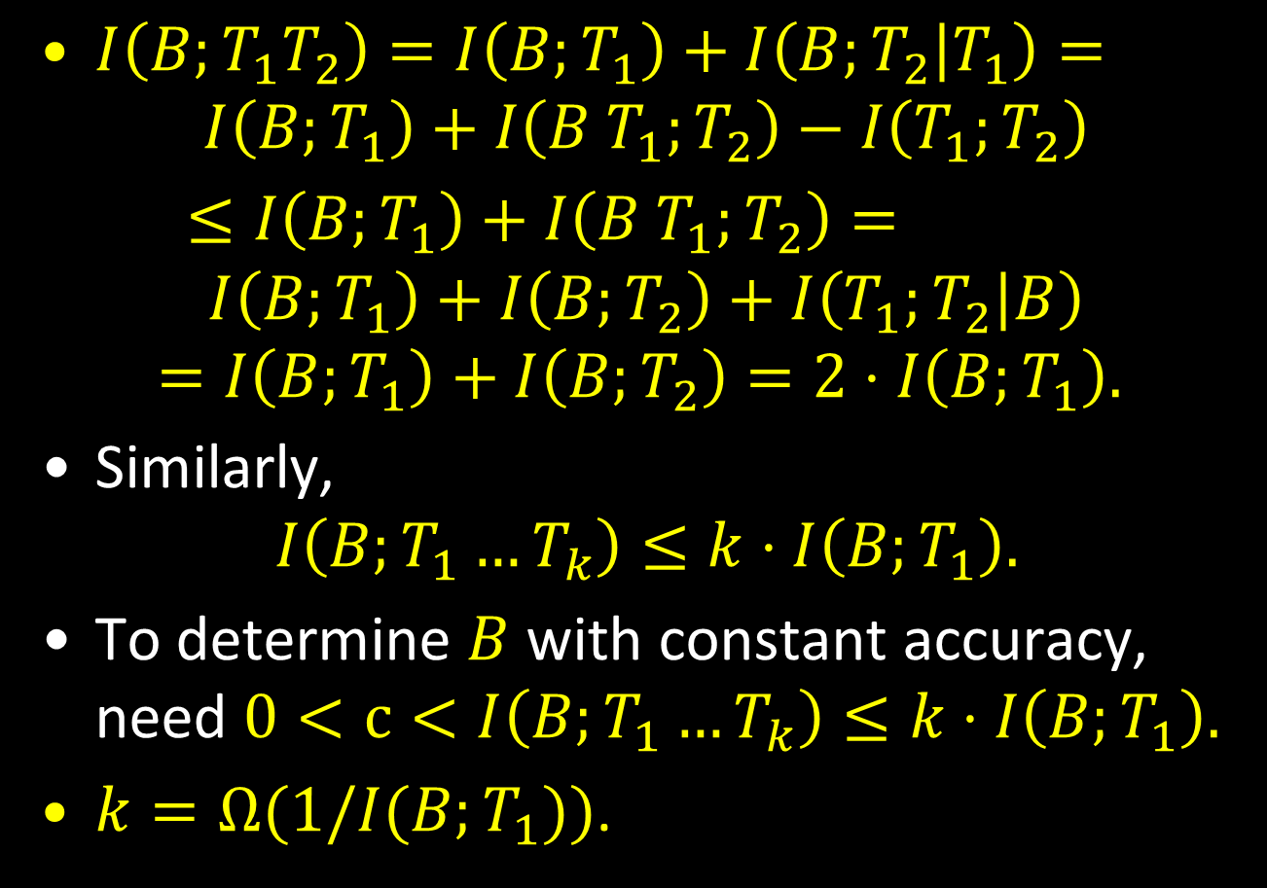

What do we learn about $B$?
$I\left(B;T_{1}T_{2}\right)=I\left(B;T_{1}\right)+I\left(B;T_{2} | T_{1}\right)=$
$$I\left(B;T_{1}\right)+I\left(B T_{1};T_{2}\right)−I\left(T_{1};T_{2}\right)$$
$≤I\left(B;T_{1}\right)+I\left(B T_{1};T_{2}\right)=$ $$I\left(B;T_{1}\right)+I\left(B;T_{2}\right)+I\left(T_{1};T_{2} | B\right)$$
$$=I\left(B;T_{1}\right)+I\left(B;T_{2}\right)=2⋅I\left(B;T_{1}\right).$$
Similarly,
$$I\left(B;T_{1}…T_{k}\right)≤k⋅I\left(B;T_{1}\right).$$
To determine $B$ with constant accuracy, need $0<c<I\left(B;T_{1}…T_{k}\right)≤k⋅I\left(B;T_{1}\right).$
$k=Ω(1/I(B;T_{1}))$.

Slide 11
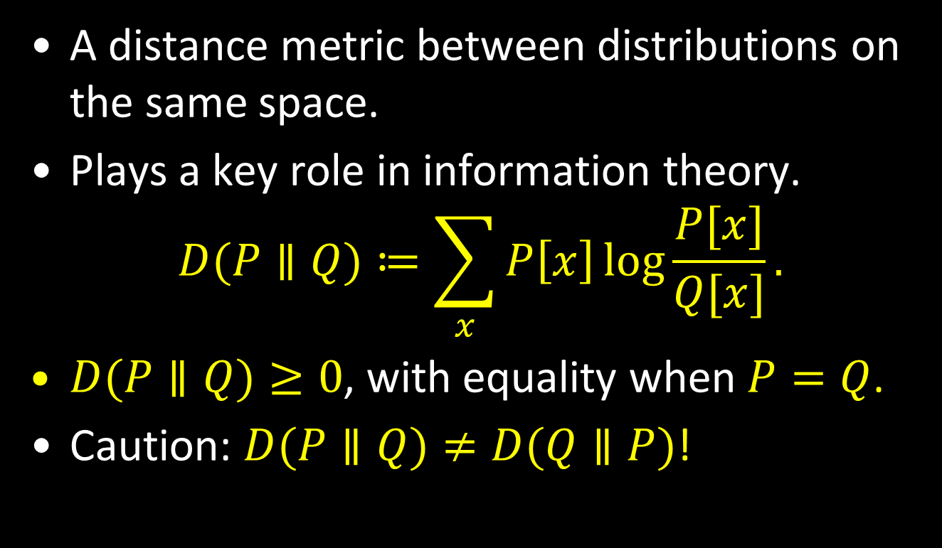
Kullback–Leibler (KL)-Divergence
A distance metric between distributions on the same space.
Plays a key role in information theory.
$$D(P∥Q)≔\sum_{x}{P\left[x\right]\log{\frac{P[x]}{Q[x]}}.}$$
$D(P∥Q)≥0$, with equality when $P=Q$.
Caution: $D(P∥Q)≠D(Q∥P)$!

Slide 12
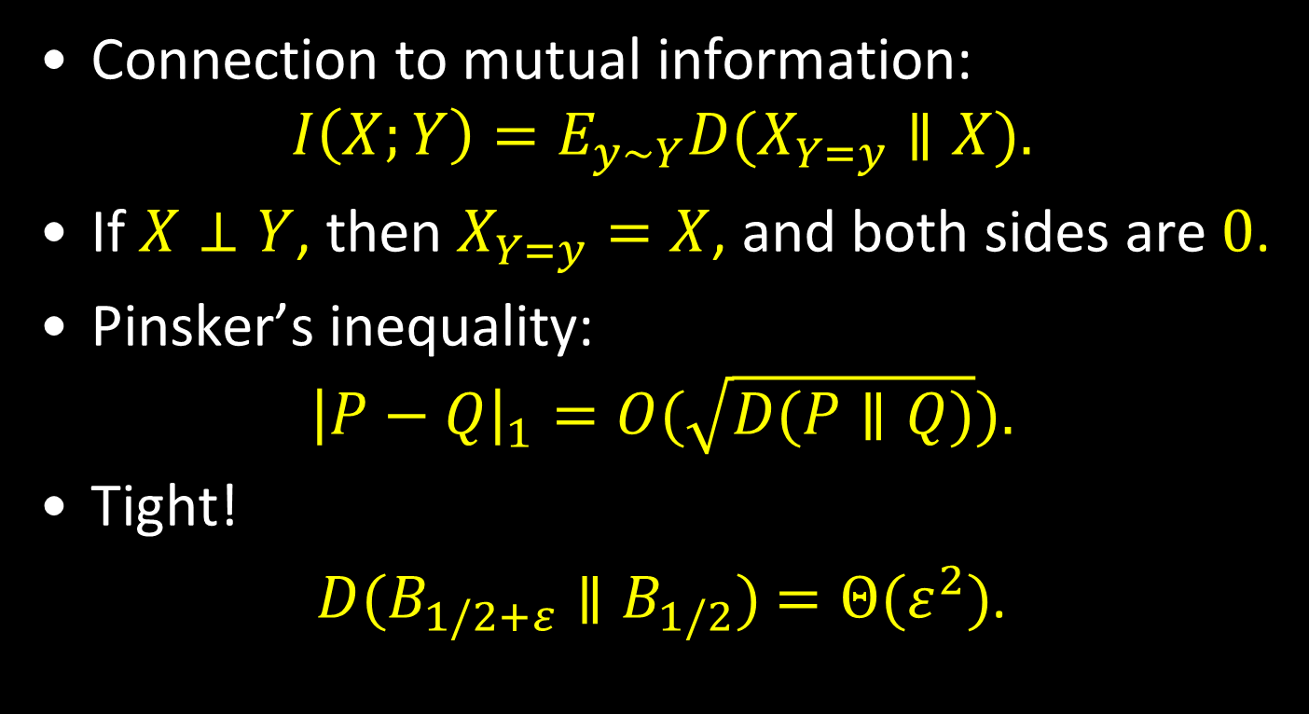
Properties of KL-divergence
Connection to mutual information:
$$I\left(X;Y\right)=E_{y∼Y}D(X_{Y=y}∥X).$$
If $X⊥Y$, then $X_{Y=y}=X$, and both sides are $0$.
Pinsker’s inequality:
$${\left|P−Q\right|}_{1}=O(\sqrt{D(P∥Q)}).$$
Tight!
$D(B_{1/2+ε}∥B_{1/2})$ $=Θ(ε^{2})$.

Slide 13
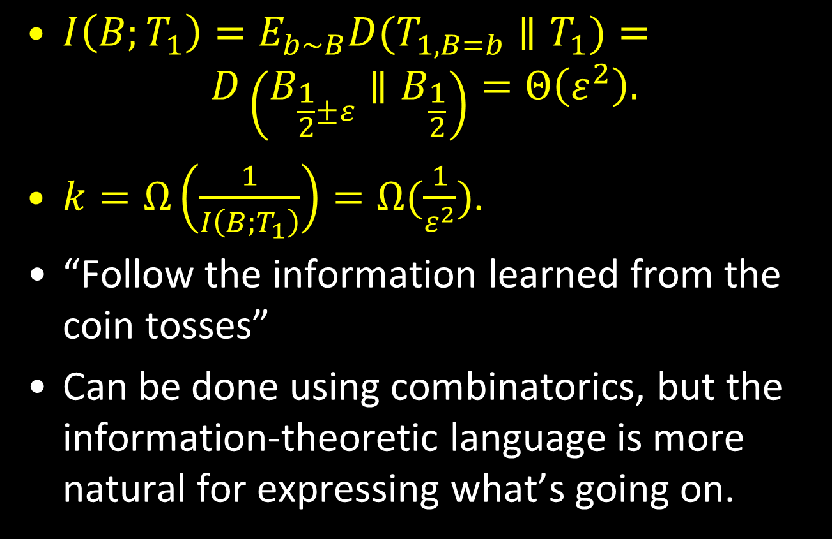
Back to the coin example
$I\left(B;T_{1}\right)=E_{b∼B}D(T_{1, B=b}∥T_{1})=$
$$D\left(B_{\frac{1}{2}±ε}∥B_{\frac{1}{2}}\right)=Θ\left(ε^{2}\right).$$
$k=Ω\left(\frac{1}{I\left(B;T_{1}\right)}\right)=Ω(\frac{1}{ε^{2}})$.
“Follow the information learned from the coin tosses”
Can be done using combinatorics, but the information-theoretic language is more natural for expressing what’s going on.

Slide 14
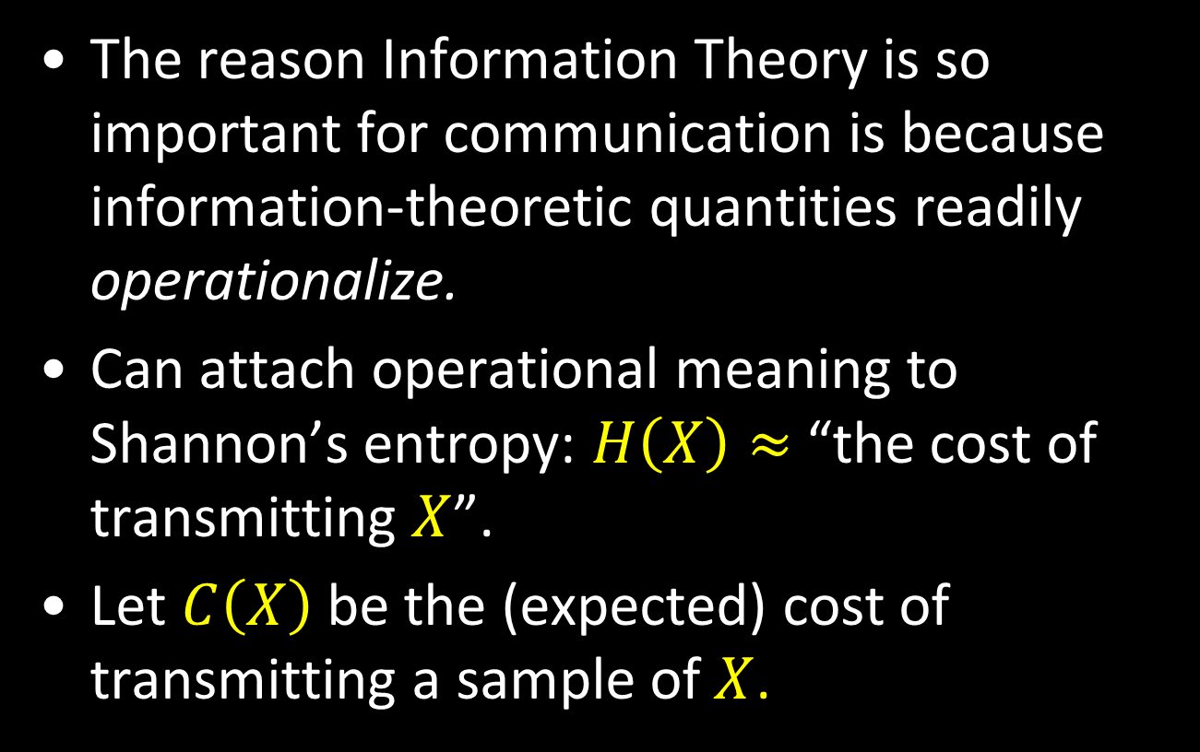
Back to communication
The reason Information Theory is so important for communication is because information-theoretic quantities readily operationalize.
Can attach operational meaning to Shannon’s entropy: $H\left(X\right)≈$ “the cost of transmitting $X$”.
Let $C\left(X\right)$ be the (expected) cost of transmitting a sample of $X$.

Slide 15
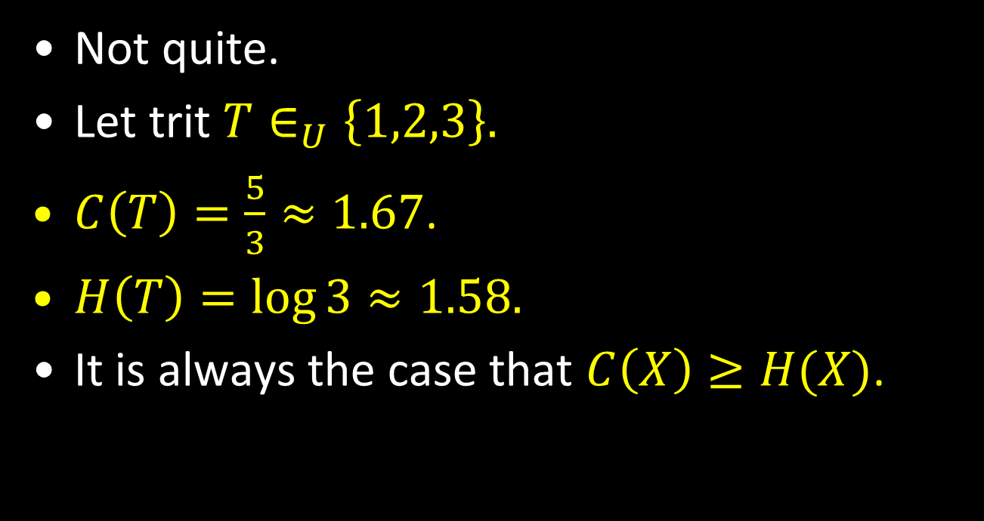

$H\left(X\right)=C(X)$?
Not quite.
Let trit $T∈_{U}\left\{1,2,3\right\}.$
$C\left(T\right)=\frac{5}{3}≈1.67$.
$H\left(T\right)=\log{3}≈1.58.$
It is always the case that $C\left(X\right)≥H(X)$.
1 | 0
2 | 10
3 | 11

Slide 16
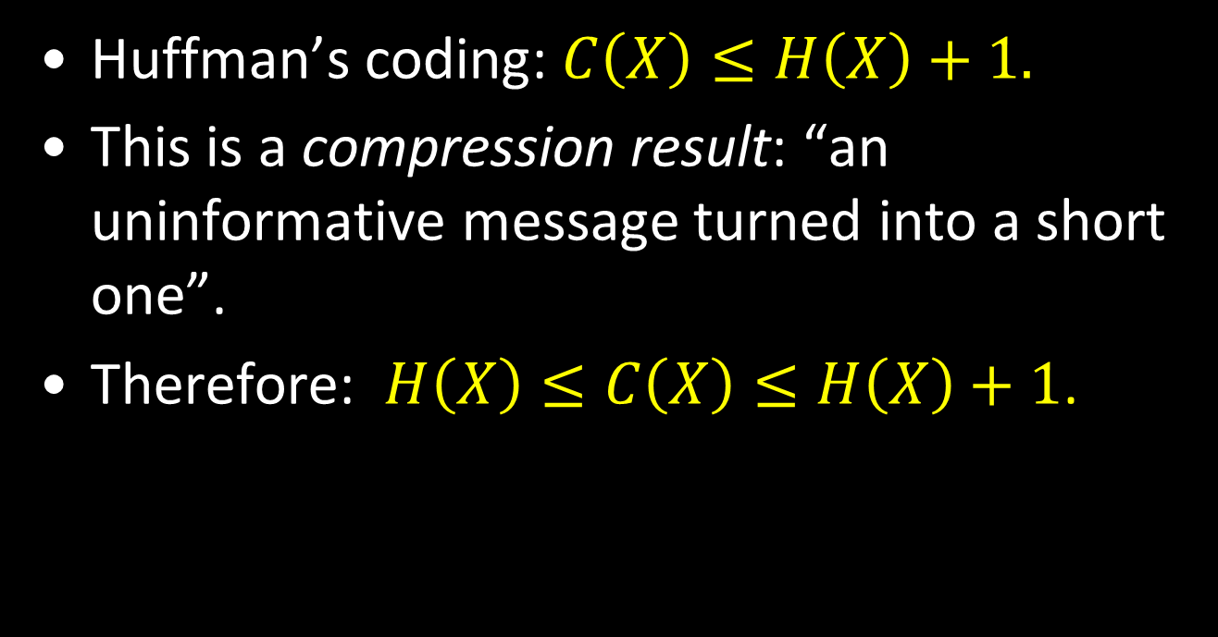

But $H\left(X\right)$ and $C(X)$ are close
Huffman’s coding: $C\left(X\right)≤H\left(X\right)+1.$
This is a compression result: “an uninformative message turned into a short one”.
Therefore: $H\left(X\right)≤C\left(X\right)≤H\left(X\right)+1$.

Slide 17
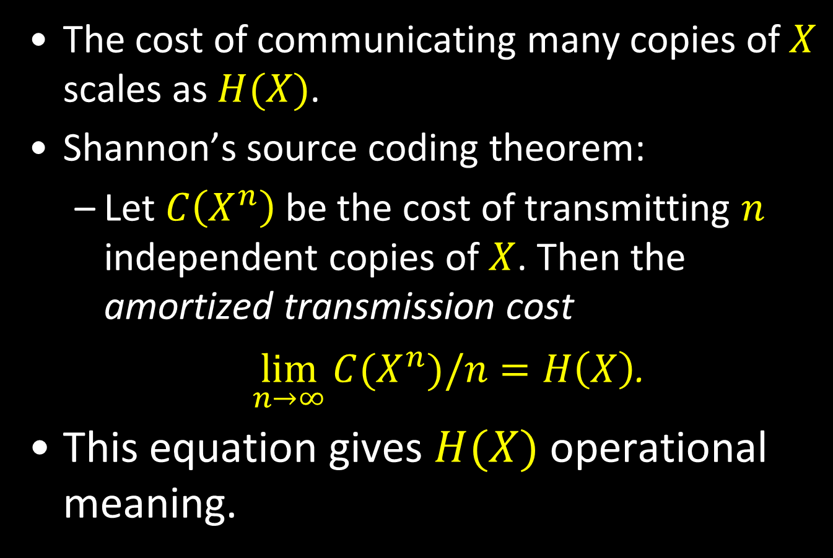
Shannon’s noiseless coding
The cost of communicating many copies of $X$ scales as $H(X)$.
Shannon’s source coding theorem:
Let $C\left(X^{n}\right)$ be the cost of transmitting $n$ independent copies of $X$. Then the amortized transmission cost
$\lim_{n→∞}{C(X^{n})/n}=H\left(X\right)$.
This equation gives $H(X)$ operational meaning.

Slide 18

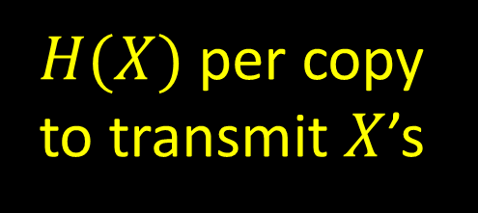
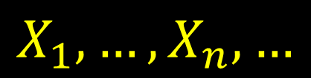
$$H\left(X\right) operationalized$$
$$X_{1},…,X_{n},…$$
$H(X)$ per copy to transmit $X$’s
communication channel

Slide 19
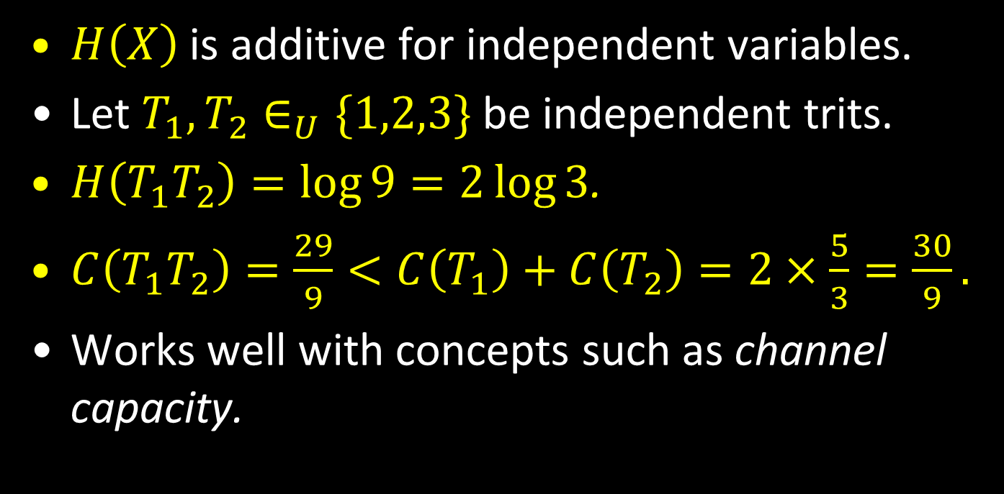

$H(X)$ is nicer than $C(X)$
$H\left(X\right)$ is additive for independent variables.
Let $T_{1},T_{2}∈_{U}\{1,2,3\}$ be independent trits.
$H\left(T_{1}T_{2}\right)=\log{9}=2\log{3}$.
$C\left(T_{1}T_{2}\right)=\frac{29}{9}<C\left(T_{1}\right)+C\left(T_{2}\right)=2×\frac{5}{3}=\frac{30}{9}.$
Works well with concepts such as channel capacity.

Slide 20
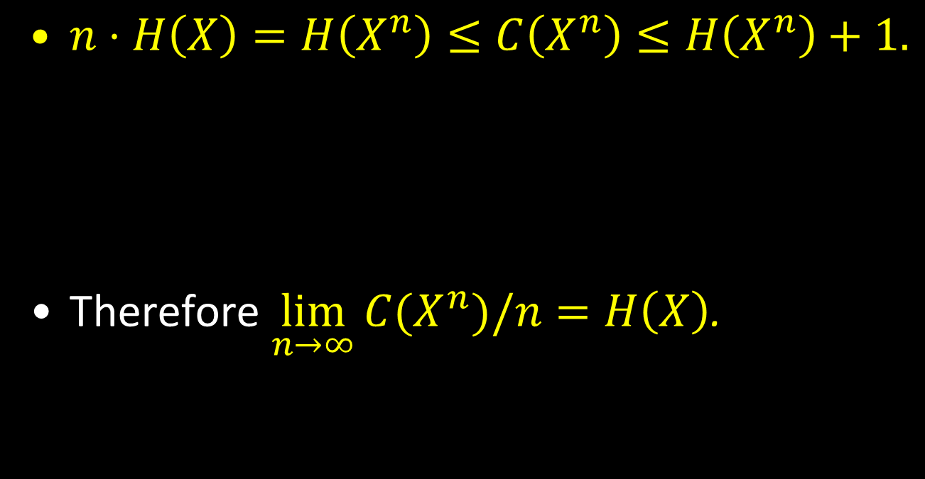
“Proof” of Shannon’s noiseless coding
$n⋅H\left(X\right)=H\left(X^{n}\right)≤C\left(X^{n}\right)≤H\left(X^{n}\right)+1.$
Therefore $\lim_{n→∞}{C(X^{n})/n}=H\left(X\right)$.
Additivity of entropy
Compression (Huffman)

Slide 21


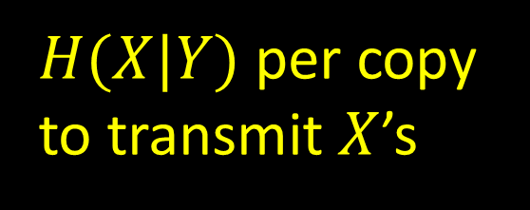

Operationalizing other quantities
Conditional entropy $H\left(X | Y\right):$
(cf. Slepian-Wolf Theorem).
$$X_{1},…,X_{n},…$$
$H(X|Y)$ per copy to transmit $X$’s
$$Y_{1},…,Y_{n},…$$
communication channel

Slide 22


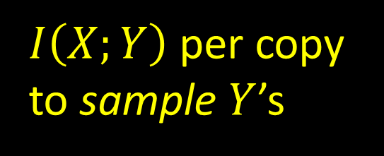
Operationalizing other quantities
Mutual information $I\left(X;Y\right)$:
$$Y_{1},…,Y_{n},…$$
$$X_{1},…,X_{n},…$$
$I\left(X;Y\right)$ per copy to sample $Y$’s
communication channel

Slide 23
Information theory and entropy
Allows us to formalize intuitive notions.
Operationalized in the context of one-way transmission and related problems.
Has nice properties (additivity, chain rule…)
Next, we discuss extensions to more interesting communication scenarios.

Slide 24




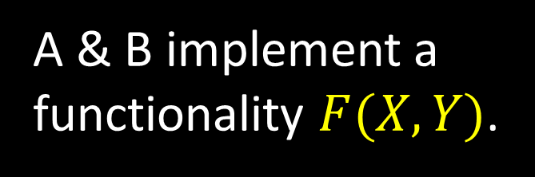
Communication complexity
Focus on the two party randomized setting.
Shared randomness R
X
A & B implement a functionality $F(X,Y)$.
Y
F(X,Y)
A
B
e.g. $F\left(X,Y\right)=“X=Y?”$

Slide 25
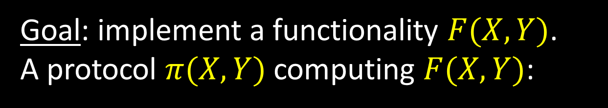
Communication complexity
Goal: implement a functionality $F(X,Y)$.
A protocol $π(X,Y)$ computing $F(X,Y)$:
Shared randomness R
X
m₁(X,R)
Y
m₂(Y,m₁,R)
m₃(X,m₁,m₂,R)
A
B
F(X,Y)
Communication cost = #of bits exchanged.

Slide 26
Communication complexity
Numerous applications/potential applications (some will be discussed later today).
Considerably more difficult to obtain lower bounds than transmission (still much easier than other models of computation!).

Slide 27
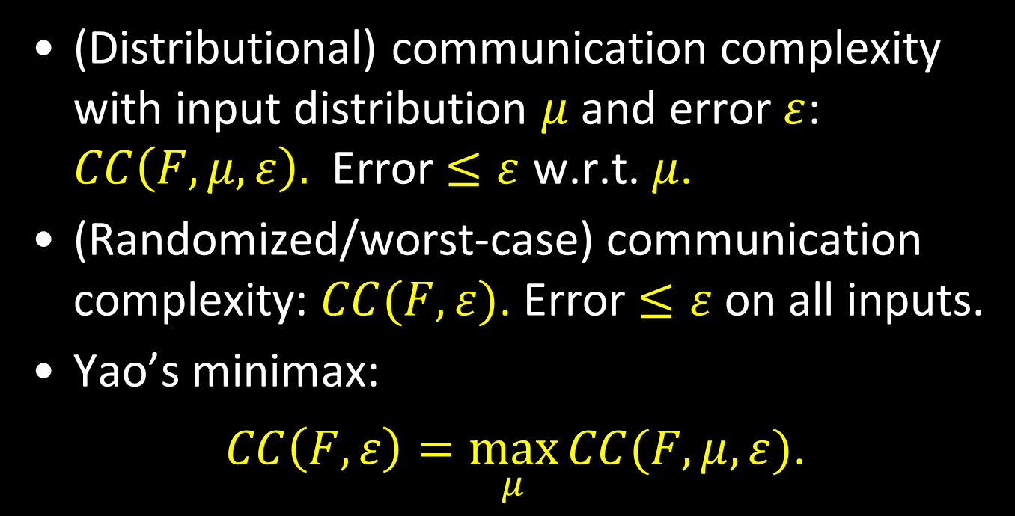
Communication complexity
(Distributional) communication complexity with input distribution $μ$ and error $ε$: $CC\left(F,μ,ε\right).$ Error $≤ε$ w.r.t. $μ$.
(Randomized/worst-case) communication complexity: $CC(F,ε)$. Error $≤ε$ on all inputs.
Yao’s minimax:
$CC\left(F,ε\right)=\max_{μ}{CC(F,μ,ε)}$.

Slide 28
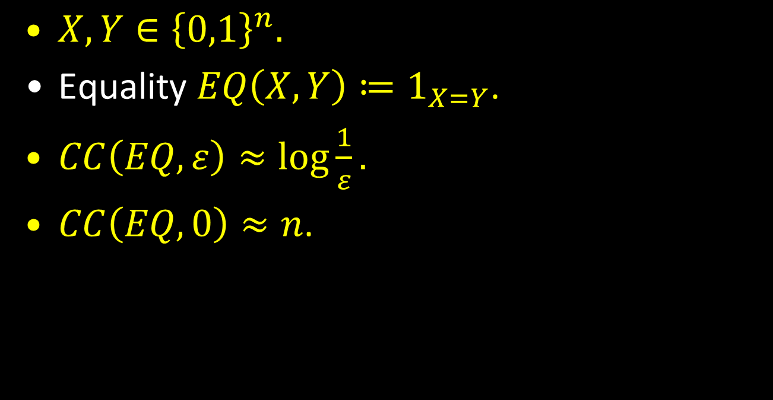
Examples
$X,Y∈{\left\{0,1\right\}}^{n}.$
Equality $EQ\left(X,Y\right)≔1_{X=Y}$.
$CC\left(EQ,ε\right)≈\log{\frac{1}{ε}.}$
$CC\left(EQ,0\right)≈n$.

Slide 29
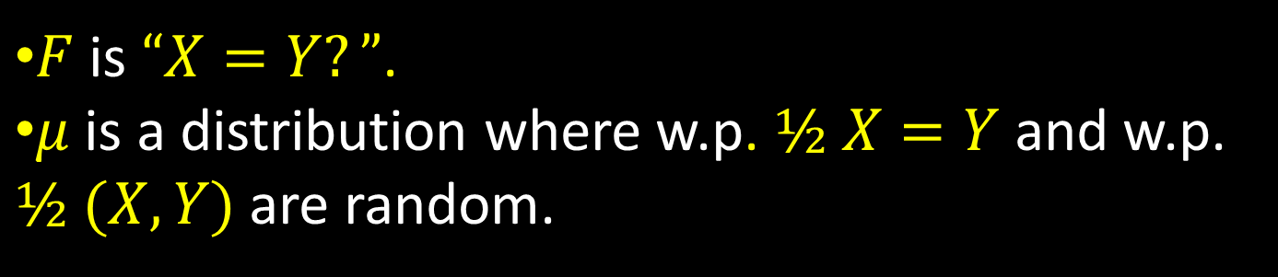
Equality
$F$is $“X=Y?”$.
$μ$is a distribution where w.p. $½ X=Y$ and w.p. $½$ $(X,Y)$ are random.
X
Y
MD5(X) [128 bits]
X=Y? [1 bit]
A
B
Error?
Shows that $CC\left(EQ,μ,2^{−129}\right)≤129.$

Slide 30
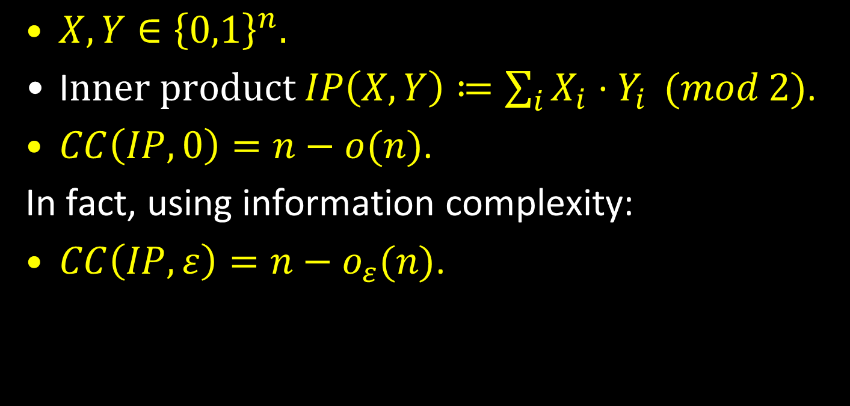
Examples
$X,Y∈{\left\{0,1\right\}}^{n}.$
I$nner product IP\left(X,Y\right)≔\sum_{i}{X_{i}⋅Y_{i}} (mod 2)$.
$CC\left(IP,0\right)=n−o(n)$.
In fact, using information complexity:
$CC\left(IP,ε\right)=n−o_{ε}(n)$.

Slide 31
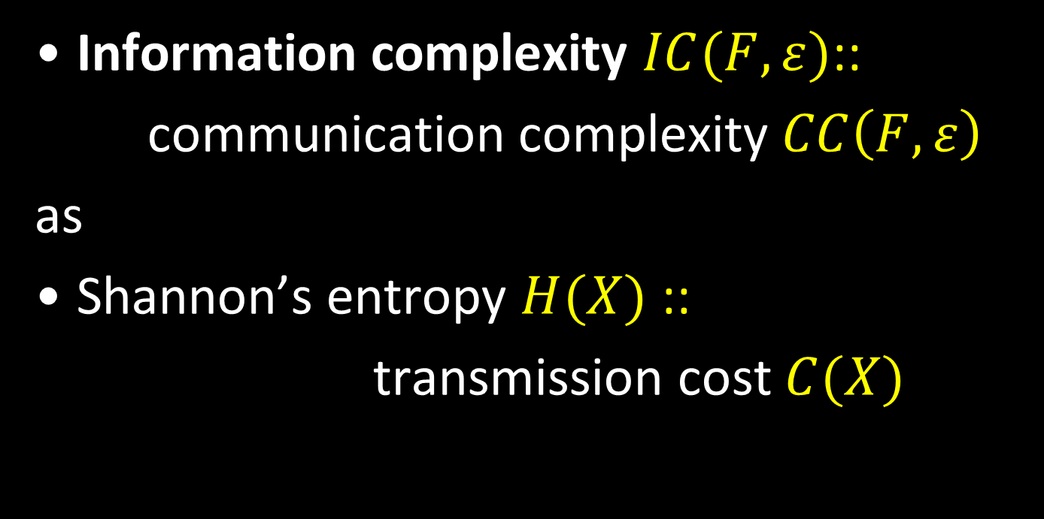
Information complexity
Information complexity $IC(F,ε)$::
communication complexity $CC\left(F,ε\right)$
as
Shannon’s entropy $H(X)$ ::
transmission cost $C(X)$

Slide 32
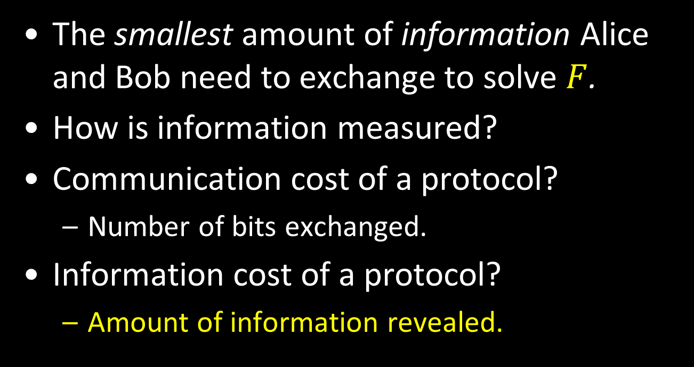
Information complexity
The smallest amount of information Alice and Bob need to exchange to solve $F$.
How is information measured?
Communication cost of a protocol?
Number of bits exchanged.
Information cost of a protocol?
Amount of information revealed.

Slide 33

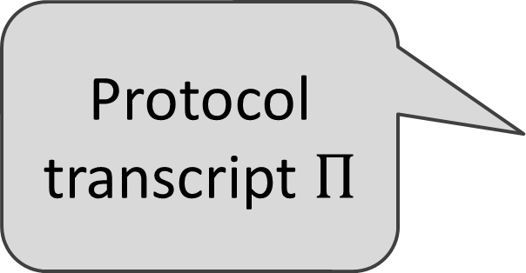
Basic definition 1: The information cost of a protocol
Prior distribution: $\left(X,Y\right)∼μ$.
X
Y
Protocol transcript $Π$
Protocol π
A
B
$$IC(π, μ) = I(Π;Y|X) + I(Π;X|Y)$$
what Alice learns about Y + what Bob learns about X

Slide 34
Example
$F$is $“X=Y?”$.
$μ$is a distribution where w.p. $½ X=Y$ and w.p. $½$ $(X,Y)$ are random.
X
Y
MD5(X) [128 bits]
X=Y? [1 bit]
A
B
$IC(π, μ) = I(Π;Y|X)+I(Π;X|Y) ≈$1 + 64.5 = 65.5 bits
what Alice learns about Y + what Bob learns about X

Slide 35
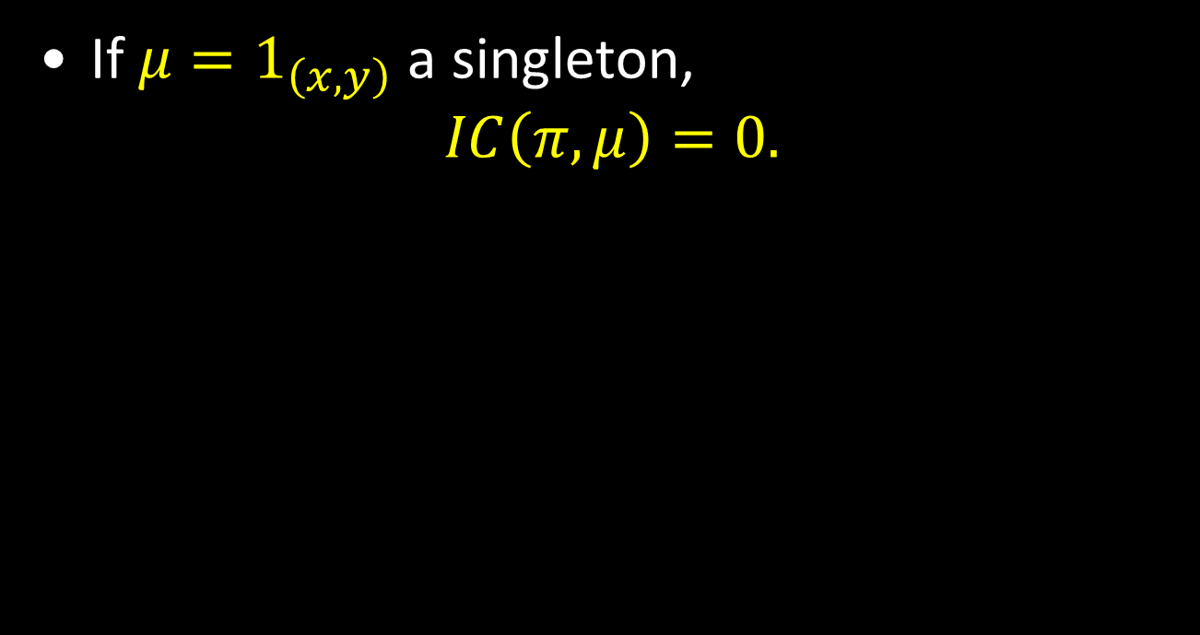

Prior $μ$ matters a lot for information cost!
If $μ=1_{\left(x,y\right)}$ a singleton,
$$IC\left(π,μ\right)=0.$$

Slide 36
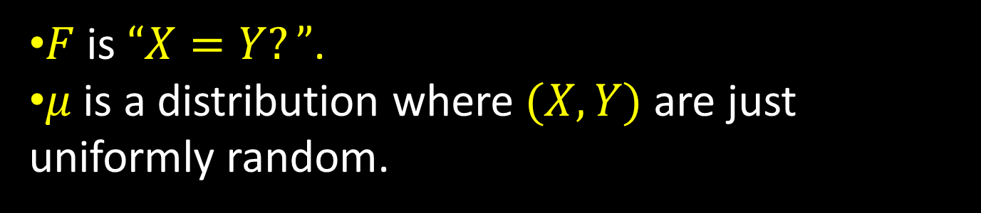
Example
$F$is $“X=Y?”$.
$μ$is a distribution where $(X,Y)$ are just uniformly random.
X
Y
MD5(X) [128 bits]
X=Y? [1 bit]
A
B
$IC(π, μ) = I(Π;Y|X)+I(Π;X|Y) ≈$0 + 128 = 128 bits
what Alice learns about Y + what Bob learns about X

Slide 37
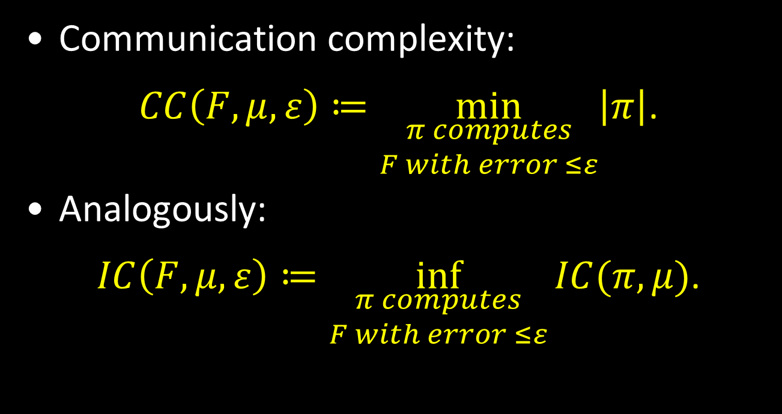
Basic definition 2: Information complexity
Communication complexity:
$CC\left(F,μ,ε\right)≔\min_{\begin{aligned}π computes \\ F with error ≤ε\end{aligned}}\left|π\right|$.
Analogously:
$IC\left(F,μ,ε\right)≔\inf_{\begin{aligned}π computes \\ F with error ≤ε\end{aligned}}{IC(π,μ)}$.
Needed!

Slide 38
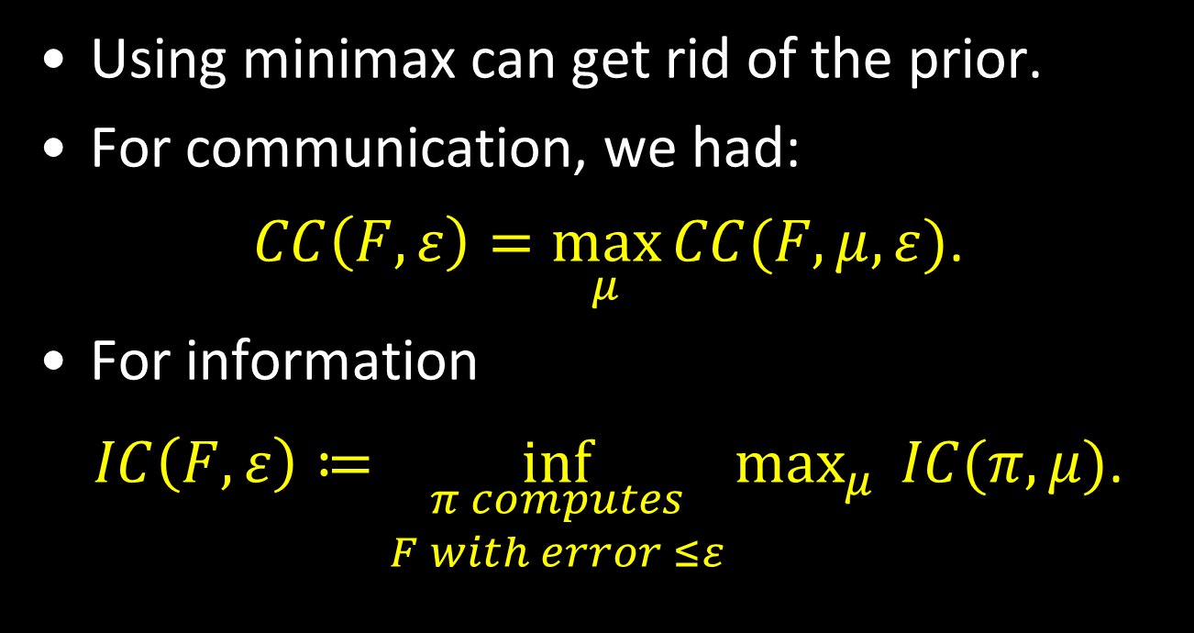
Prior-free information complexity
Using minimax can get rid of the prior.
For communication, we had:
$CC\left(F,ε\right)=\max_{μ}{CC(F,μ,ε)}$.
For information
$IC\left(F,ε\right)≔\inf_{\begin{aligned}π computes \\ F with error ≤ε\end{aligned}}{\max_{μ}{ IC(π,μ)}}$.

Slide 39

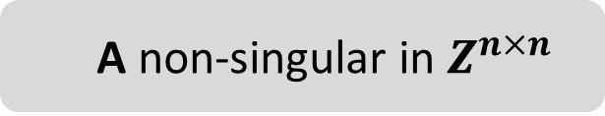
Ex: The information complexity of Equality
What is $IC(EQ,0)$?
Consider the following protocol.
A non-singular in $Z^{n×n}$
X in {0,1}^{n}
Y in {0,1}^{n}
Continue for n steps, or until a disagreement is discovered.
A₁·X
A₁·Y
A₂·X
A₂·Y
A
B

Slide 40
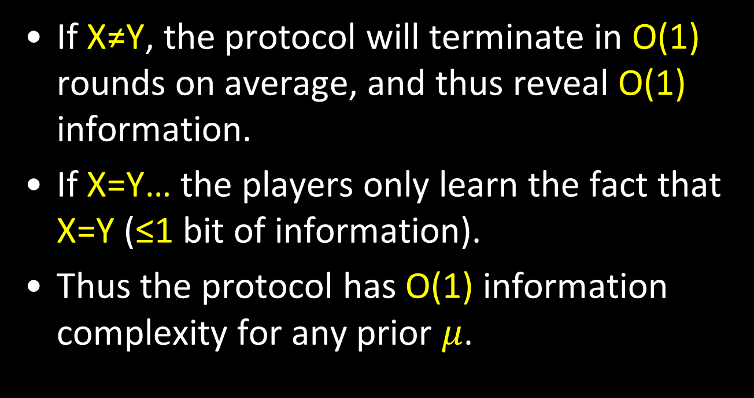
Analysis (sketch)
If X≠Y, the protocol will terminate in O(1) rounds on average, and thus reveal O(1) information.
If X=Y… the players only learn the fact that X=Y (≤1 bit of information).
Thus the protocol has O(1) information complexity for any prior $μ$.

Slide 41
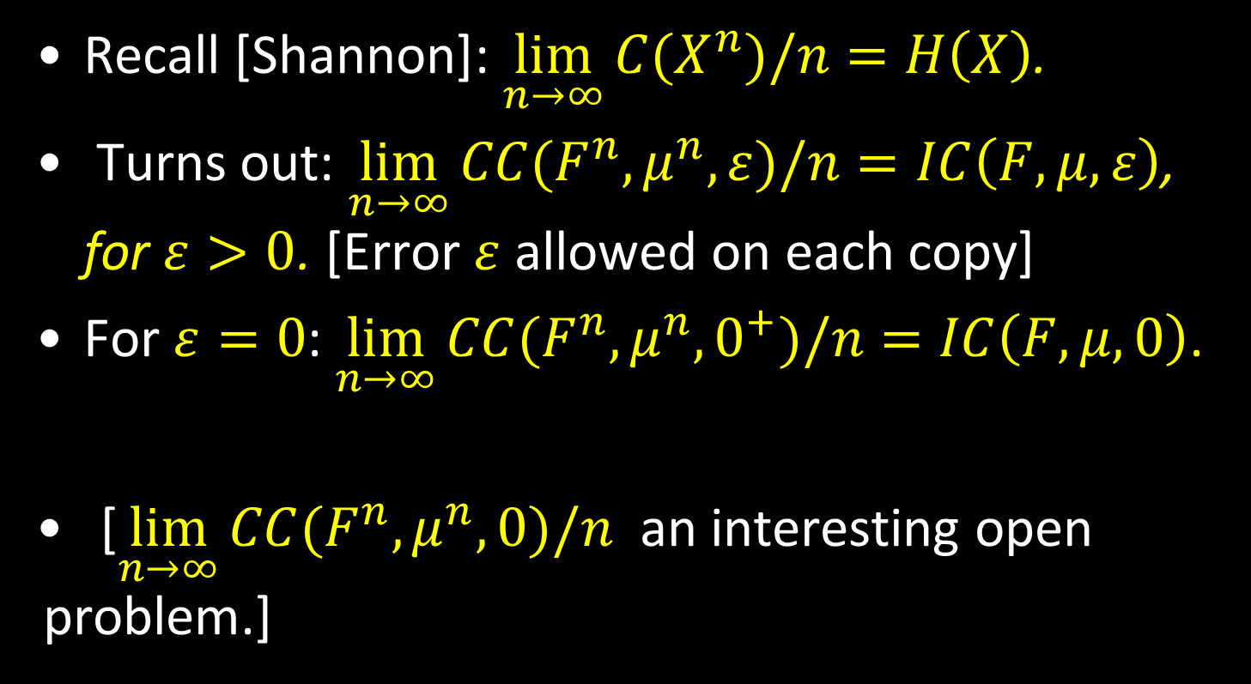
Operationalizing IC: Information equals amortized communication
Recall [Shannon]: $\lim_{n→∞}{C(X^{n})/n}=H\left(X\right)$.
Turns out: $\lim_{n→∞}{CC(F^{n},μ^{n},ε)/n}=IC\left(F,μ,ε\right)$, for $ε>0$. [Error $ε$ allowed on each copy]
For $ε=0$: $\lim_{n→∞}{CC(F^{n},μ^{n},0^{+})/n}=IC\left(F,μ,0\right)$.
[$\lim_{n→∞}{CC(F^{n},μ^{n},0)/n}$ an interesting open problem.]

Slide 42
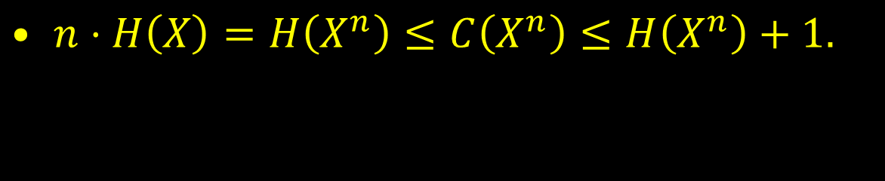
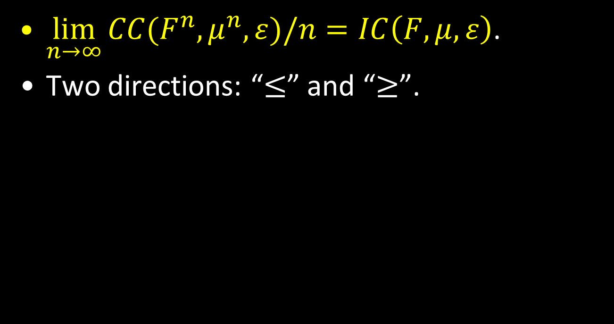
Information = amortized communication
$\lim_{n→∞}{CC(F^{n},μ^{n},ε)/n}=IC\left(F,μ,ε\right)$.
Two directions: “$≤$” and “$≥$”.
$n⋅H\left(X\right)=H\left(X^{n}\right)≤C\left(X^{n}\right)≤H\left(X^{n}\right)+1.$
Additivity of entropy
Compression (Huffman)

Slide 43
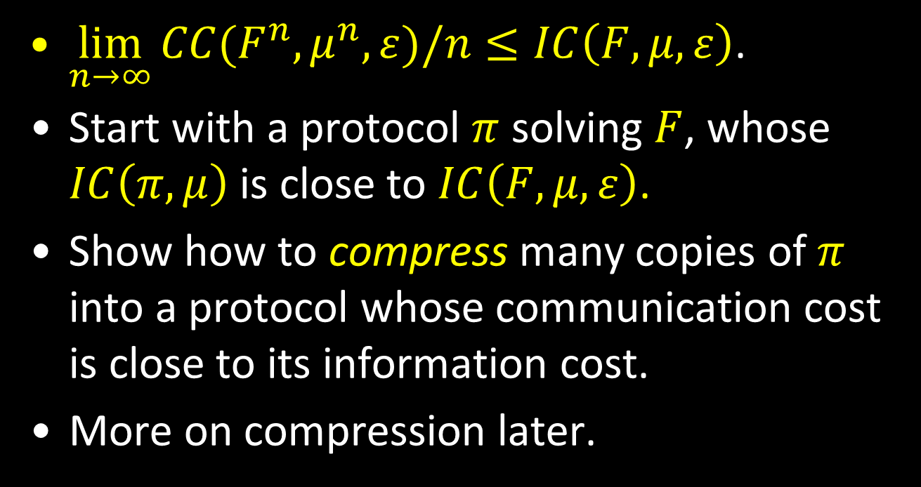

The “$≤$” direction
$\lim_{n→∞}{CC(F^{n},μ^{n},ε)/n}≤IC\left(F,μ,ε\right)$.
Start with a protocol $π$ solving $F$, whose $IC\left(π,μ\right)$ is close to $IC\left(F,μ,ε\right)$.
Show how to compress many copies of $π$ into a protocol whose communication cost is close to its information cost.
More on compression later.

Slide 44
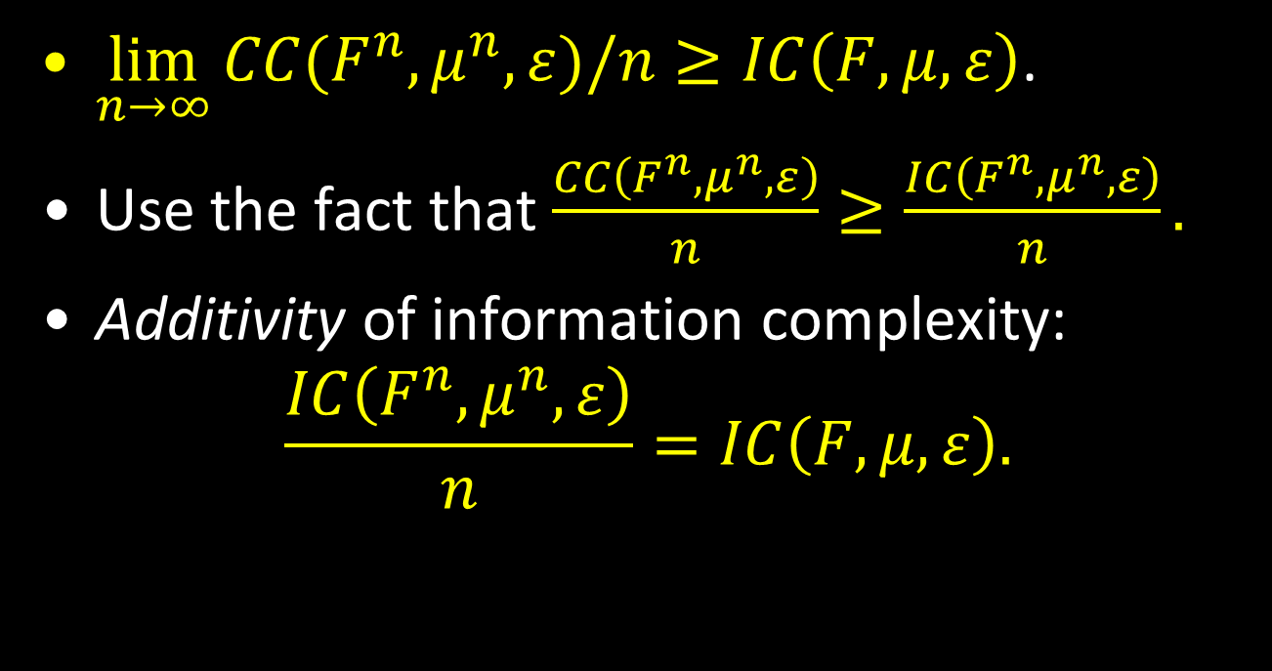

The “$≥$” direction
$\lim_{n→∞}{CC(F^{n},μ^{n},ε)/n}≥IC\left(F,μ,ε\right)$.
Use the fact that $\frac{CC\left(F^{n},μ^{n},ε\right)}{n}≥\frac{IC\left(F^{n},μ^{n},ε\right)}{n}.$
Additivity of information complexity:
$$\frac{IC\left(F^{n},μ^{n},ε\right)}{n}=IC\left(F,μ,ε\right).$$

Slide 45
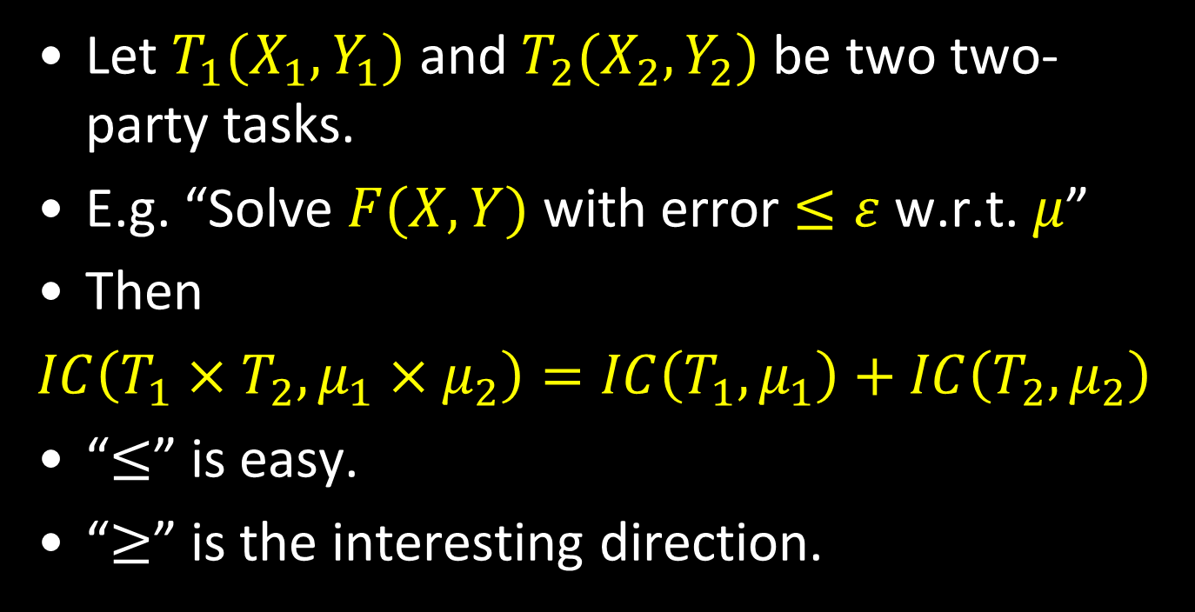
Proof: Additivity of information complexity
Let $T_{1}(X_{1},Y_{1})$ and $T_{2}(X_{2},Y_{2})$ be two two-party tasks.
E.g. “Solve $F(X,Y)$ with error $≤ε$ w.r.t. $μ$”
Then
$IC\left(T_{1}×T_{2},μ_{1}×μ_{2}\right)=IC\left(T_{1},μ_{1}\right)+$ $IC\left(T_{2},μ_{2}\right)$
“$≤$” is easy.
“$≥$” is the interesting direction.

Slide 46
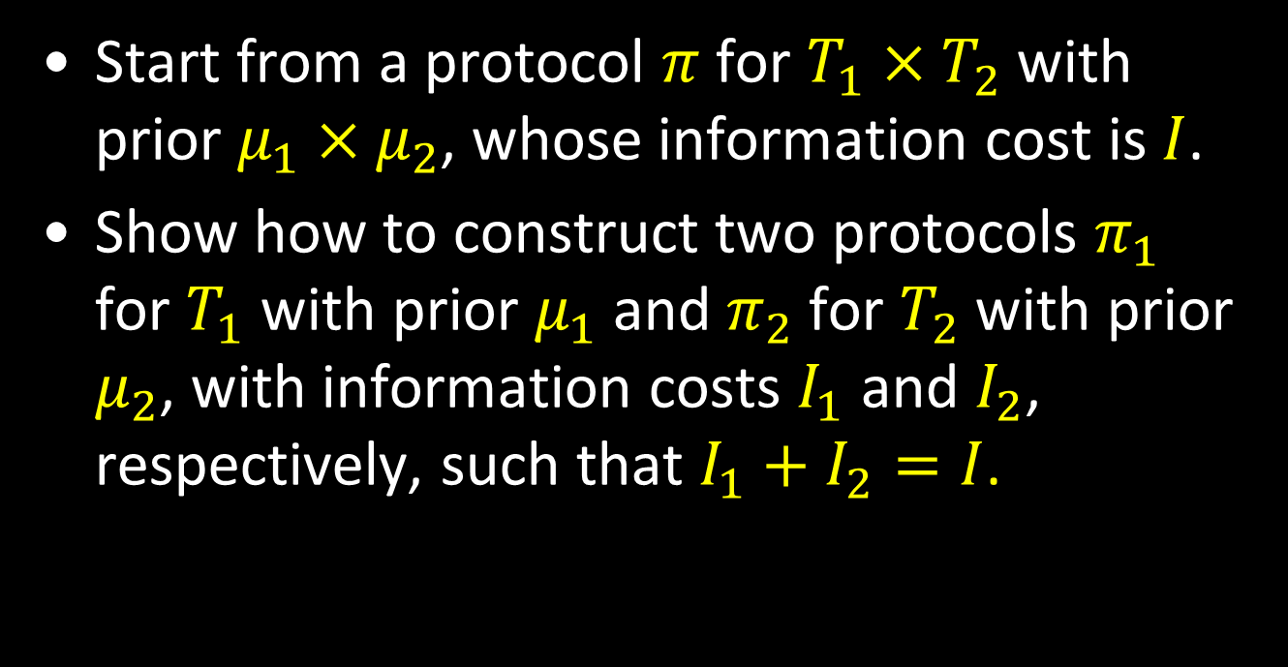

$IC\left(T_{1},μ_{1}\right)+$ $IC\left(T_{2},μ_{2}\right)≤IC\left(T_{1}×T_{2},μ_{1}×μ_{2}\right)$
Start from a protocol $π$ for $T_{1}×T_{2}$ with prior $μ_{1}×μ_{2}$, whose information cost is $I$.
Show how to construct two protocols $π_{1}$ for $T_{1}$ with prior $μ_{1}$ and $π_{2}$ for $T_{2}$ with prior $μ_{2}$, with information costs $I_{1}$ and $I_{2}$, respectively, such that $I_{1}+I_{2}=I$.

Slide 47



$$π(\left(X_{1},X_{2}\right),\left(Y_{1},Y_{2}\right))$$
$$π_{1}\left(X_{1},Y_{1}\right)$$
Publicly sample $X_{2}∼μ_{2}$
Bob privately samples $Y_{2}∼μ_{2}{\left.​\right|}_{X_{2}}$
Run $π(\left(X_{1},X_{2}\right),\left(Y_{1},Y_{2}\right))$
$$π_{2}\left(X_{2},Y_{2}\right)$$
Publicly sample $Y_{1}∼μ_{1}$
Alice privately samples $X_{1}∼μ_{1}{\left.​\right|}_{Y_{1}}$
Run $π(\left(X_{1},X_{2}\right),\left(Y_{1},Y_{2}\right))$

Slide 48



Analysis - $π_{1}$
$$π_{1}\left(X_{1},Y_{1}\right)$$
Publicly sample $X_{2}∼μ_{2}$
Bob privately samples $Y_{2}∼μ_{2}{\left.​\right|}_{X_{2}}$
Run $π(\left(X_{1},X_{2}\right),\left(Y_{1},Y_{2}\right))$
Alice learns about $Y_{1}$:
$$I\left(Π;Y_{1}\right|X_{1}X_{2})$$
Bob learns about $X_{1}:$
$$I\left(Π;X_{1}\right|Y_{1}Y_{2}X_{2}).$$
$I_{1}=I\left(Π;Y_{1}\right|X_{1}X_{2})+I\left(Π;X_{1}\right|Y_{1}Y_{2}X_{2}).$

Slide 49



Analysis - $π_{2}$
$$π_{2}\left(X_{2},Y_{2}\right)$$
Publicly sample $Y_{1}∼μ_{1}$
Alice privately samples $X_{1}∼μ_{1}{\left.​\right|}_{Y_{1}}$
Run $π(\left(X_{1},X_{2}\right),\left(Y_{1},Y_{2}\right))$
Alice learns about $Y_{2}$:
$$I\left(Π;Y_{2}\right|X_{1}X_{2}Y_{1})$$
Bob learns about $X_{2}:$
$$I\left(Π;X_{2}\right|Y_{1}Y_{2}).$$
$I_{2}=I\left(Π;Y_{2}\right|X_{1}X_{2}Y_{1})+I\left(Π;X_{2}\right|Y_{1}Y_{2}).$

Slide 50


Adding $I_{1}$ and $I_{2}$
$$I_{1}+I_{2}$$
$$=I\left(Π;Y_{1}\right|X_{1}X_{2})+I\left(Π;X_{1}\right|Y_{1}Y_{2}X_{2})+I\left(Π;Y_{2}\right|X_{1}X_{2}Y_{1})+I\left(Π;X_{2}\right|Y_{1}Y_{2})$$
$=I\left(Π;Y_{1}\right|X_{1}X_{2})+$ $I\left(Π;Y_{2}\right|X_{1}X_{2}Y_{1})+I\left(Π;X_{2}\right|Y_{1}Y_{2})+I\left(Π;X_{1}\right|Y_{1}Y_{2}X_{2})=$
$I\left(Π;Y_{1}Y_{2} | X_{1}X_{2}\right)+I\left(Π;X_{2}X_{1} | Y_{1}Y_{2}\right)=I$.

Slide 51

Summary
Information complexity is additive.
Operationalized via “Information = amortized communication”.
$\lim_{n→∞}{CC(F^{n},μ^{n},ε)/n}=IC\left(F,μ,ε\right)$.
Seems to be the “right” analogue of entropy for interactive computation.

Slide 52

Entropy vs. Information Complexity
 | Entropy | IC
Additive? | Yes | Yes
Operationalized | $$\lim_{n→∞}{C(X^{n})/n}$$ | $$\lim_{n→∞}{\frac{CC\left(F^{n},μ^{n},ε\right)}{n}}$$
Compression? | Huffman: $C\left(X\right)≤H\left(X\right)+1$ | ???!

Slide 53

Can interactive communication be compressed?
Is it true that $CC\left(F,μ,ε\right)≤IC\left(F,μ, ε\right)+O(1)$?
Less ambitiously:
$$CC\left(F,μ,O(ε)\right)=O\left(IC\left(F,μ, ε\right)\right)?$$
(Almost) equivalently: Given a protocol $π$ with $IC\left(π,μ\right)=I$, can Alice and Bob simulate $π$ using $O\left(I\right)$ communication?
Not known in general…

Slide 54

Direct sum theorems
Let $F$ be any functionality.
Let $C(F)$ be the cost of implementing $F$.
Let $Fn$ be the functionality of implementing $n$ independent copies of $F$.
The direct sum problem:
“Does $C(F^{n}) ≈ n∙C(F)$?”
In most cases it is obvious that $C(F^{n})≤n∙C(F)$.

Slide 55

Direct sum – randomized communication complexity
Is it true that
$CC(Fn,μn,ε) = Ω(n∙CC(F,μ,ε))$?
Is it true that $CC(Fn,ε) = Ω(n∙CC(F,ε))$?

Slide 56

Direct product – randomized communication complexity
Direct sum
$CC(Fn,μn,ε) = Ω(n∙CC(F,μ,ε))$?
Direct product
$CC(Fn,μn, {(1−ε)}^{n}) = Ω(n∙CC(F,μ,ε))$?

Slide 57

Direct sum for randomized CC and interactive compression
Direct sum:
$CC(Fn,μn,ε) = Ω(n∙CC(F,μ,ε))$?
In the limit:
$n⋅IC(F,μ,ε) = Ω(n∙CC(F,μ,ε))$?
Interactive compression:
$CC\left(F,μ,ε\right)=O(IC\left(F,μ, ε)\right)$?
Same question!

Slide 58




The big picture
additivity (=direct sum) for information
$$IC(F, μ,ε)$$
$$IC(Fn,μ^{n},ε)/n$$
information = amortized communication
interactive compression?
direct sum for communication?
$$CC(F, μ,ε)$$
$$CC(Fn,μ^{n},ε)/n$$

Slide 59

Current results for compression
A protocol $π$that has $C$ bits of communication, conveys $I$ bits of information over prior $μ$, and works in $r$ rounds can be simulated:
Using $\tilde{O}(I+r)$ bits of communication.
Using $\tilde{O}\left(\sqrt{I⋅C}\right)$ bits of communication.
Using $2^{O(I)}$ bits of communication.
If $μ=μ_{X}×μ_{Y}$, then using $O(I\operatorname{polylog}{C)}$ bits of communication.

Slide 60

Their direct sum counterparts
$CC(Fn,μn,ε) = \tilde{Ω}(n^{1/2}∙CC(F,μ,ε)).$
$CC(Fn,ε) = \tilde{Ω}(n^{1/2}∙CC(F,ε)).$
For product distributions $μ=μ_{X}×μ_{Y}$,
$CC(Fn,μn,ε) = \tilde{Ω}(n∙CC(F,μ,ε)).$
When the number of rounds is bounded by $r≪n$, a direct sum theorem holds.

Slide 61

Direct product
The best one can hope for is a statement of the type:
$$CC(Fn,μn,1−2^{−O\left(n\right)}) =Ω(n∙IC(F,μ,1/3)).$$
Can prove:
$$CC\left(Fn,μn,1−2^{−O\left(n\right)}\right)=\tilde{Ω}(n^{1/2}∙CC(F,μ,1/3)).$$

Slide 62

Proof 2: Compressing a one-round protocol
Say Alice speaks: $IC\left(π,μ\right)=I\left(M;X | Y\right).$
Recall KL-divergence:
$$I\left(M;X | Y\right)=E_{Y} D\left(M_{XY}∥M_{Y}\right)=E_{Y} D\left(M_{X}∥M_{Y}\right)$$
Bottom line:
Alice has $M_{X}$; Bob has $M_{Y}$;
Goal: sample from $M_{X}$ using $∼D(M_{X}∥M_{Y})$ communication.

Slide 63


The dart board
Interpret the public randomness as random points in $U×[0,1]$, where $U$ is the universe of all possible messages.
First message under the histogram of $M$ is distributed $∼M$.
q₁
u₁
q₂
u₂
q₃
u₃
q₄
u₄
q₅
u₅
q₆
u₆
q₇
u₇
….
1
u₃
u₄
u₁
u₂
u₅
0
$$U$$

Slide 64



Proof Idea
Sample using $O(log⁡1/ε+D(MX∥MY))$ communication with statistical error ε.
Public randomness:
~|U| samples
1
q₁
1
u₁
q₂
u₂
q₃
u₃
q₄
u₄
q₅
u₅
q₆
u₆
q₇
u₇
….
M_{X}
M_{Y}
u₃
u₃
u₁
u₁
u₄
u₂
u₄
u₂
0
0
M_{X}
u₄
M_{Y}

Slide 65


Proof Idea
Sample using $O(log⁡1/ε+D(MX∥MY))$ communication with statistical error ε.
1
1
M_{X}
M_{Y}
u₄
u₂
0
0
u₂
h₁(u₄)
h₂(u₄)
M_{Y}
M_{X}
u₄
☹

Slide 66



Proof Idea
Sample using $O(log⁡1/ε+D(MX∥MY))$ communication with statistical error ε.
1
1
M_{X}
2M_{Y}
u₄
u₄
u₂
0
u₄
0
h₃(u₄)
h₄(u₄)…
h_{log 1/ ε}(u₄)
M_{Y}
M_{X}
u₄
66
☺
h₁(u₄), h₂(u₄)

Slide 67


Analysis
If $MX(u4)≈2k MY(u4)$, then the protocol will reach round $k$ of doubling.
There will be $≈2k$ candidates.
About $k+log⁡1/ε$ hashes to narrow to one.
The contribution of $u4$ to cost:
$MX(u4) (log⁡MX (u4)/MY (u4) + log⁡1/ε).$
Done!
$$D(M_{X}∥M_{Y})≔\sum_{u}{M_{X}(u)\log{\frac{M_{X}(u)}{M_{Y}(u)}}.}$$

Slide 68


External information cost
$(X,Y) \sim μ$.
X
C
Y
Protocol transcript π
Protocol π
A
B
$$ICext(π, μ) = I(Π;XY)$$
what Charlie learns about (X,Y)

Slide 69
Example
F is “X=Y?”.
μ is a distribution where w.p. ½ X=Y and w.p. ½ (X,Y) are random.
X
Y
MD5(X)
X=Y?
A
B
$$ICext(π, μ) = I(Π;XY) = 129 bits$$
what Charlie learns about (X,Y)

Slide 70

External information cost
It is always the case that
$${IC}_{ext}\left(π,μ\right)≥IC\left(π,μ\right).$$
If $μ=μ_{X}×μ_{Y}$ is a product distribution, then
$${IC}_{ext}\left(π,μ\right)=IC\left(π,μ\right).$$

Slide 71

External information complexity
$IC_{ext}\left(F,μ,ε\right)≔\inf_{\begin{aligned}π computes \\ F with error ≤ε\end{aligned}}{IC_{ext}(π,μ)}$.
Can it be operationalized?

Slide 72


Operational meaning of $IC_{ext}$?
Conjecture: Zero-error communication scales like external information:
$$\lim_{n→∞}{\frac{CC\left(F^{n},μ^{n},0\right)}{n}}=IC_{ext}\left(F,μ,0\right)?$$
Recall:
$$\lim_{n→∞}{\frac{CC\left(F^{n},μ^{n},0^{+}\right)}{n}}=IC\left(F,μ,0\right).$$

Slide 73

Example – transmission with a strong prior
$X,Y∈\left\{0,1\right\}$
$μ$ is such that $X∈_{U}\left\{0,1\right\}$, and $X=Y$ with a very high probability (say $1−1/\sqrt{n}$).
$F\left(X,Y\right)=X$ is just the “transmit $X$” function.
Clearly, $π$ should just have Alice send $X$ to Bob.
$IC\left(F,μ,0\right)=IC\left(π,μ\right)=H\left(\frac{1}{\sqrt{n}}\right)=o(1)$.
$IC_{ext}\left(F,μ,0\right)={IC}_{ext}\left(π,μ\right)=1.$

Slide 74

Example – transmission with a strong prior
$IC\left(F,μ,0\right)=IC\left(π,μ\right)=H\left(\frac{1}{\sqrt{n}}\right)=o(1)$.
$IC_{ext}\left(F,μ,0\right)={IC}_{ext}\left(π,μ\right)=1.$
$CC\left(F^{n},μ^{n},0^{+}\right)=o\left(n\right).$
$CC\left(F^{n},μ^{n},0\right)=Ω(n).$
Other examples, e.g. the two-bit AND function fit into this picture.

Slide 75
Additional directions
Information complexity
Interactive coding
Information theory in TCS

Slide 76

Interactive coding theory
So far focused the discussion on noiseless coding.
What if the channel has noise?
[What kind of noise?]
In the non-interactive case, each channel has a capacity $C$.

Slide 77

Channel capacity
The amortized number of channel uses needed to send $X$ over a noisy channel of capacity $C$ is
$$\frac{H\left(X\right)}{C}$$
Decouples the task from the channel!

Slide 78





Example: Binary Symmetric Channel
Each bit gets independently flipped with probability $ε<1/2.$
One way capacity $1−H\left(ε\right).$
$$1−ε$$
0
0
$$ε$$
$$ε$$
1
1
$$1−ε$$

Slide 79




Interactive channel capacity
Not clear one can decouple channel from task in such a clean way.
Capacity much harder to calculate/reason about.
Example: Binary symmetric channel.
One way capacity $1−H\left(ε\right).$
Interactive (for simple pointer jumping,
[Kol-Raz’13]):
$$1−Θ\left(\sqrt{H\left(ε\right)}\right).$$
$$1−ε$$
0
0
$$ε$$
1
1
$$1−ε$$

Slide 80

Information theory in communication complexity and beyond
A natural extension would be to multi-party communication complexity.
Some success in the number-in-hand case.
What about the number-on-forehead?
Explicit bounds for $≥\log{n}$ players would imply explicit $ACC^{0}$ circuit lower bounds.

Slide 81

Naïve multi-party information cost
YZ
XZ
XY
A
B
C
$IC\left(π,μ\right)=I(Π;X|YZ)\text{+}$ $I(Π;Y|XZ)$+ $I(Π;Z|XY)$

Slide 82

Naïve multi-party information cost
$IC\left(π,μ\right)=I(Π;X|YZ)\text{+}$ $I(Π;Y|XZ)$+ $I(Π;Z|XY)$
Doesn’t seem to work.
Secure multi-party computation [Ben-Or,Goldwasser, Wigderson], means that anything can be computed at near-zero information cost.
Although, these construction require the players to share private channels/randomness.

Slide 83
Communication and beyond…
The rest of today:
Data structures;
Streaming;
Distributed computing;
Privacy.
Exact communication complexity bounds.
Extended formulations lower bounds.
Parallel repetition?
…

Slide 84
Thank You!

Slide 85

Open problem: Computability of IC
Given the truth table of $F\left(X,Y\right)$, $μ$ and $ε$, compute $IC\left(F,μ,ε\right).$
Via $IC\left(F,μ,ε\right)=\lim_{n→∞}{CC(F^{n},μ^{n},ε)/n}$ can compute a sequence of upper bounds.
But the rate of convergence as a function of $n$ is unknown.

Slide 86

Open problem: Computability of IC
Can compute the $r$-round$IC_{r}\left(F,μ,ε\right)$ information complexity of $F$.
But the rate of convergence as a function of $r$ is unknown.
Conjecture:
$$IC_{r}\left(F,μ,ε\right)−IC\left(F,μ,ε\right)=O_{F,μ,ε}\left(\frac{1}{r^{2}}\right).$$
This is the relationship for the two-bit AND.

